Slide 1
Mood, Mod, Voice
Nick Riches
Homework
Mood, Mod, Voice
Mood
Types of mood, with examples
Mood in other languages
Declarative Mood
Interrogative Mood EXERCISE
Int errors DLD Ints in ASD
Exclamative mood
Imperative mood
17 - Mood, Modality and Voice
Nick Riches
Newcastle University
Modality
The basics Getting tricky
Permission modals Will
Can
Semi-modals EXERCISE
Clinical relevance
compiled on March 24, 2020
Voice
The basics
Passive gets bad press! Lang.imp. popns
Homework
References
1 / 57

Slide 2
Mood, Mod, Voice
Nick Riches
Homework
Homework
Mood, modality and voice
Mood, Mod, Voice
Mood
Types of mood, with examples
Mood in other languages
Declarative Mood
Interrogative Mood EXERCISE
Int errors DLD Ints in ASD
Exclamative mood
Imperative mood
Mood
Modality
Voice
Modality
The basics Getting tricky
Permission modals Will
Can
Semi-modals EXERCISE
Clinical relevance
Homework References
Voice
The basics
Passive gets bad press! Lang.imp. popns
Homework
References
1 / 57

Slide 3
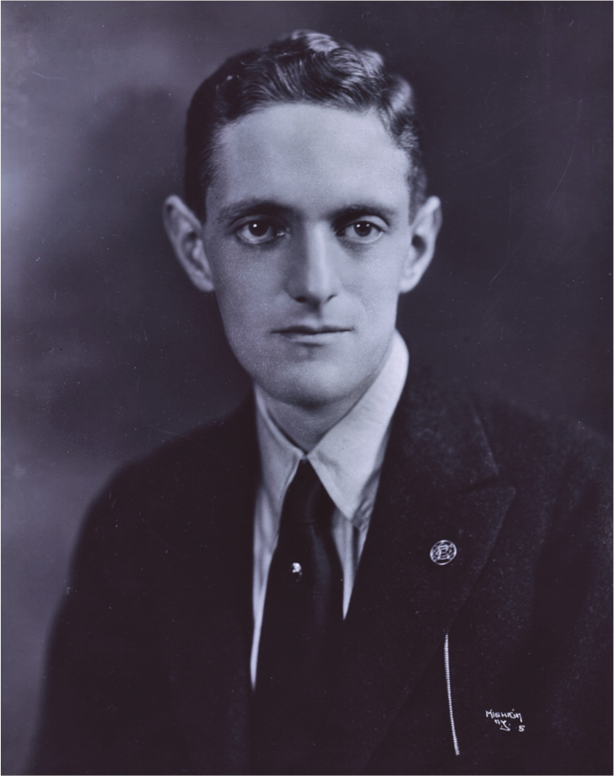
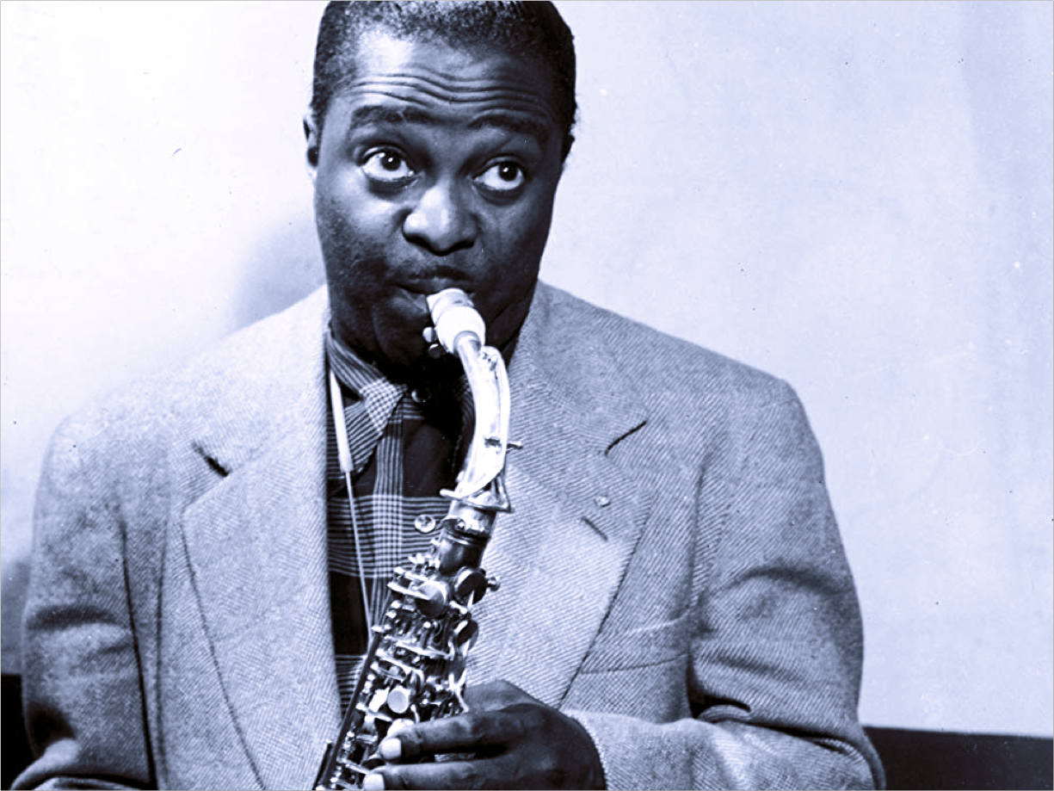
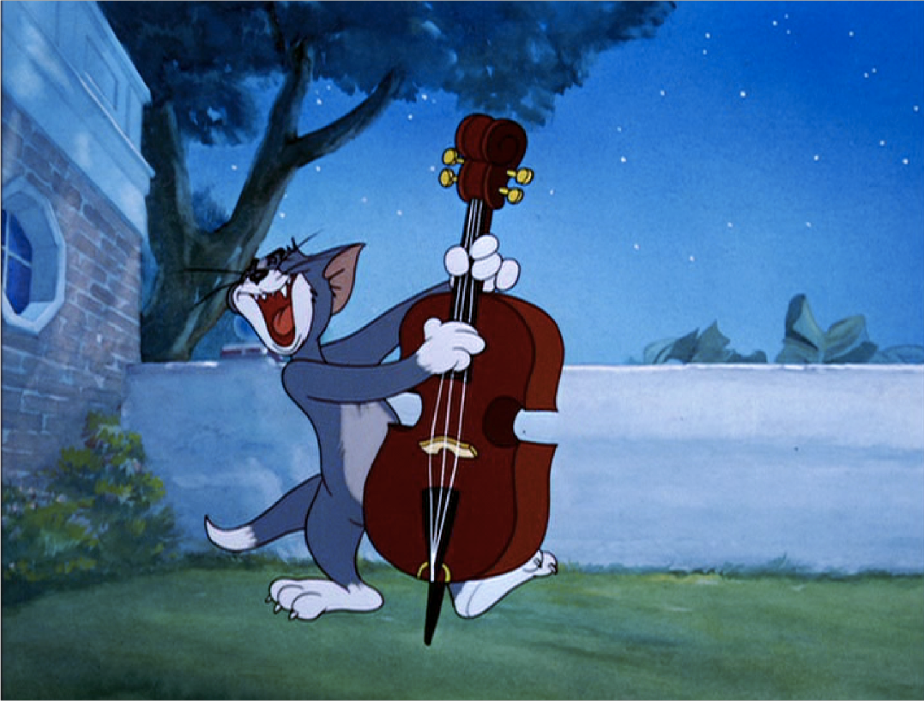

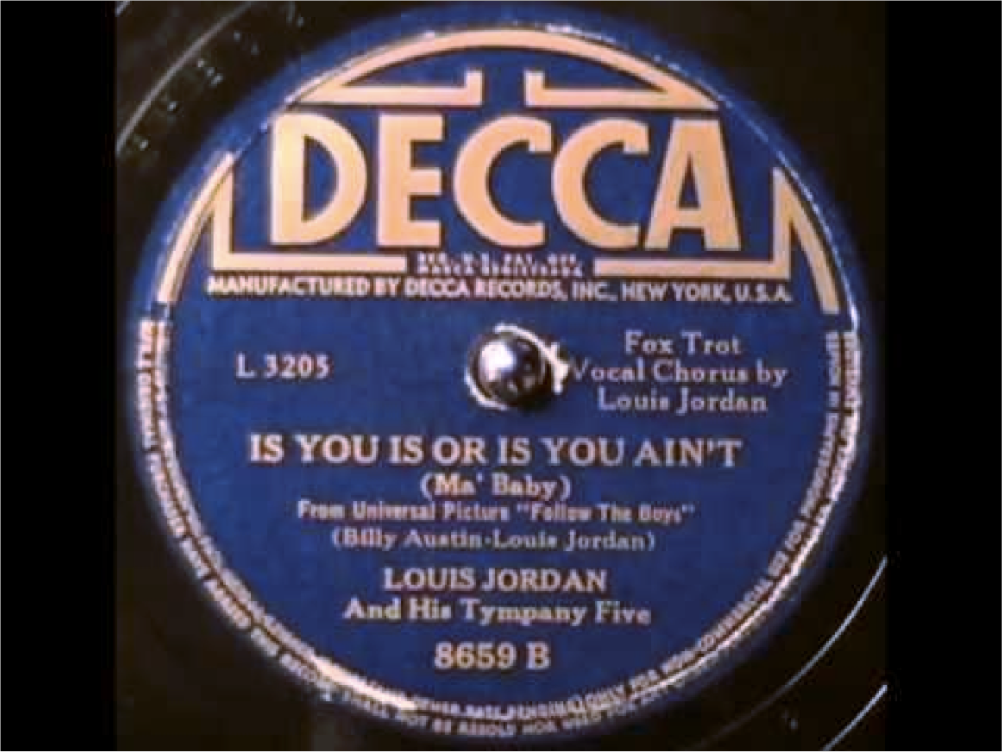
Mood, Mod, Voice
Nick Riches
Homework
Is you is, or is you ain’t my baby?
Mood, Mod, Voice
Mood
Types of mood, with examples
Mood in other languages
Declarative Mood
Interrogative Mood EXERCISE
Int errors DLD Ints in ASD
Exclamative mood
Imperative mood
Octavius Roy Cohen
Lewis Jordan
Modality
The basics Getting tricky
Permission modals Will
Can
Semi-modals EXERCISE
Clinical relevance
Tom and Jerry
Voice
The basics
Passive gets bad press! Lang.imp. popns
Homework
References
2 / 57

Slide 4
Mood, Mod, Voice
Nick Riches
Homework
Mood, Mod, Voice
Mood
Types of mood, with examples
Mood in other languages
Declarative Mood
Interrogative Mood EXERCISE
Int errors DLD Ints in ASD
Exclamative mood
Imperative mood
Is you is, or is you ain’t my baby?
Non-standard agreement morphology (you is. . . )
Non-standard form of negated copula (ain’t)
Movement without deletion (see later)
Modality
The basics Getting tricky
Permission modals Will
Can
Semi-modals EXERCISE
Clinical relevance
Voice
The basics
Passive gets bad press! Lang.imp. popns
Homework
References
3 / 57

Slide 5
Mood, Mod, Voice
Nick Riches
Homework
Homework
Mood, modality and voice
Mood, Mod, Voice
Mood
Types of mood, with examples
Mood in other languages
Declarative Mood
Interrogative Mood EXERCISE
Int errors DLD Ints in ASD
Exclamative mood
Imperative mood
Mood
Modality
Voice
Modality
The basics Getting tricky
Permission modals Will
Can
Semi-modals EXERCISE
Clinical relevance
Homework References
Voice
The basics
Passive gets bad press! Lang.imp. popns
Homework
References
3 / 57

Slide 6
Mood, Mod, Voice
Nick Riches
Homework
Mood, Mod, Voice
Mood
Types of mood, with examples
Mood in other languages
Declarative Mood
Interrogative Mood EXERCISE
Int errors DLD Ints in ASD
Exclamative mood
Imperative mood
All phenomena which can be used to manipulate the proposition expressed by a sentence.
Mood and modality are devices whereby speakers express their attitude to what they they are saying.
Voice is a means of foregrounding (or “topicalising”) particular arguments
Modality
The basics Getting tricky
Permission modals Will
Can
Semi-modals EXERCISE
Clinical relevance
Voice
The basics
Passive gets bad press! Lang.imp. popns
Homework
References
4 / 57

Slide 7
Mood, Mod, Voice
Nick Riches
Homework
Homework
Mood, modality and voice
Mood, Mod, Voice
Mood
Types of mood, with examples
Mood in other languages
Declarative Mood
Interrogative Mood EXERCISE
Int errors DLD Ints in ASD
Exclamative mood
Imperative mood
Mood
Modality
Voice
Modality
The basics Getting tricky
Permission modals Will
Can
Semi-modals EXERCISE
Clinical relevance
Homework References
Voice
The basics
Passive gets bad press! Lang.imp. popns
Homework
References
4 / 57

Slide 8
Types of mood, with examples
Mood, Mod, Voice
Nick Riches
Homework
Mood, Mod, Voice
Mood
Types of mood, with examples
Mood in other languages
Declarative Mood
Interrogative Mood EXERCISE
Int errors DLD Ints in ASD
Exclamative mood
Imperative mood
In English “moods” are typically aligned with Speech Acts; DECLARATIVE MOOD
(1) She _{S.} is _{V.} late for work _{Cs} .
Modality
The basics Getting tricky
Permission modals Will
Can
Semi-modals EXERCISE
Clinical relevance
(2) The cat _{S.} ate _{V.} the fish _{Od} .
Voice
The basics
Passive gets bad press! Lang.imp. popns
Homework
References
5 / 57

Slide 9
Types of mood, with examples
Mood, Mod, Voice
Nick Riches
Homework
Mood, Mod, Voice
Mood
Types of mood, with examples
Mood in other languages
Declarative Mood
Interrogative Mood EXERCISE
Int errors DLD Ints in ASD
Exclamative mood
Imperative mood
INTERROGATIVE MOOD
Who do you work for ?
Why are you being so mean ?
Modality
The basics Getting tricky
Permission modals Will
Can
Semi-modals EXERCISE
Clinical relevance
Voice
The basics
Passive gets bad press! Lang.imp. popns
Homework
References
6 / 57

Slide 10
Types of mood, with examples
Mood, Mod, Voice
Nick Riches
Homework
Mood, Mod, Voice
Mood
Types of mood, with examples
Mood in other languages
Declarative Mood
Interrogative Mood EXERCISE
Int errors DLD Ints in ASD
Exclamative mood
Imperative mood
IMPERATIVE MOOD
Don’t do that !
Go away !
Modality
The basics Getting tricky
Permission modals Will
Can
Semi-modals EXERCISE
Clinical relevance
Voice
The basics
Passive gets bad press! Lang.imp. popns
Homework
References
7 / 57

Slide 11
Types of mood, with examples
Mood, Mod, Voice
Nick Riches
Homework
Mood, Mod, Voice
Mood
Types of mood, with examples
Mood in other languages
Declarative Mood
Interrogative Mood EXERCISE
Int errors DLD Ints in ASD
Exclamative mood
Imperative mood
EXCLAMATIVE MOOD
What a terrible film !
Boy was it awful !
Modality
The basics Getting tricky
Permission modals Will
Can
Semi-modals EXERCISE
Clinical relevance
Voice
The basics
Passive gets bad press! Lang.imp. popns
Homework
References
8 / 57

Slide 12
Mood in other languages
Mood, Mod, Voice
Nick Riches
Homework
Mood, Mod, Voice
Mood
Types of mood, with examples
Mood in other languages
Declarative Mood
Interrogative Mood EXERCISE
Int errors DLD Ints in ASD
Exclamative mood
Imperative mood
e.g. Romance has a subjunctive mood to refer to events which are hypothetical
Modality
The basics Getting tricky
Permission modals Will
Can
Semi-modals EXERCISE
Clinical relevance
Voice
The basics
Passive gets bad press! Lang.imp. popns
Homework
References
9 / 57

Slide 13
(1) Declarative Mood
Mood, Mod, Voice
Nick Riches
Homework
Mood, Mod, Voice
Mood
Types of mood, with examples
Mood in other languages
Declarative Mood
Interrogative Mood EXERCISE
Int errors DLD Ints in ASD
Exclamative mood
Imperative mood
In most discourses, most sentences will be in the declarative mood.
Displays canonical word order (S + V + complement)
She _{S} is _{V} late for work _{Comp = Cs}
The cat _{S} ate _{V} the fish _{Comp = Od}
Modality
The basics Getting tricky
Permission modals Will
Can
Semi-modals EXERCISE
Clinical relevance
Voice
The basics
Passive gets bad press! Lang.imp. popns
Homework
References
10 / 57

Slide 14
(2) Interrogative Mood
Mood, Mod, Voice
Nick Riches
Homework
Mood, Mod, Voice
Mood
Types of mood, with examples
Mood in other languages
Declarative Mood
Interrogative Mood EXERCISE
Int errors DLD Ints in ASD
Exclamative mood
Imperative mood
2 processes
Wh-movement
Inversion of Auxiliary or Copula
Modality
The basics Getting tricky
Permission modals Will
Can
Semi-modals EXERCISE
Clinical relevance
Voice
The basics
Passive gets bad press! Lang.imp. popns
Homework
References
11 / 57

Slide 15
(2) Interrogative Mood
Mood, Mod, Voice
Nick Riches
Homework
Mood, Mod, Voice
Mood
Types of mood, with examples
Mood in other languages
Declarative Mood
Interrogative Mood EXERCISE
Int errors DLD Ints in ASD
Exclamative mood
Imperative mood
‘wh’ questions begin with ‘wh’-word
Who is he dating?
Yes-no questions require a yes-no response
Is he dating Brad?
Modality
The basics Getting tricky
Permission modals Will
Can
Semi-modals EXERCISE
Clinical relevance
Voice
The basics
Passive gets bad press! Lang.imp. popns
Homework
References
12 / 57

Slide 16
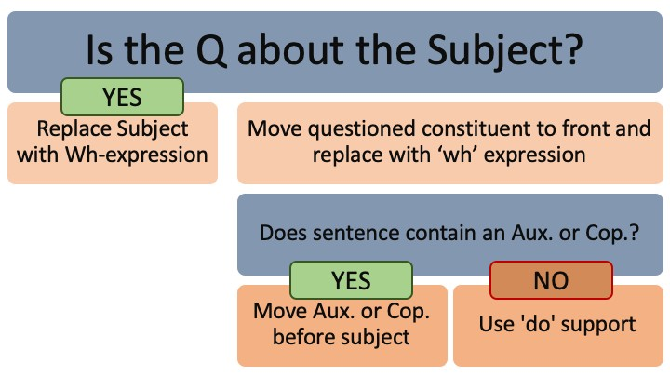
(2) Interrogative Mood
Mood, Mod, Voice
Nick Riches
Homework
Question formation in ‘wh’-questions
Mood, Mod, Voice
Mood
Types of mood, with examples
Mood in other languages
Declarative Mood
Interrogative Mood EXERCISE
Int errors DLD Ints in ASD
Exclamative mood
Imperative mood
Modality
The basics Getting tricky
Permission modals Will
Can
Semi-modals EXERCISE
Clinical relevance
Voice
The basics
Passive gets bad press! Lang.imp. popns
Homework
References
13 / 57

Slide 17
(2) Interrogative Mood
Mood, Mod, Voice
Nick Riches
Homework
Mood, Mod, Voice
Mood
Types of mood, with examples
Mood in other languages
Declarative Mood
Interrogative Mood EXERCISE
Int errors DLD Ints in ASD
Exclamative mood
Imperative mood
1.
X
ate the fish
Modality
The basics Getting tricky
Permission modals Will
Can
Semi-modals EXERCISE
Clinical relevance
Voice
The basics
Passive gets bad press! Lang.imp. popns
Homework
References
14 / 57

Slide 18
(2) Interrogative Mood
Mood, Mod, Voice
Nick Riches
Homework
Mood, Mod, Voice
Mood
Types of mood, with examples
Mood in other languages
Declarative Mood
Interrogative Mood EXERCISE
Int errors DLD Ints in ASD
Exclamative mood
Imperative mood
1. X ate the fish
2. Who ate the fish ?
Modality
The basics Getting tricky
Permission modals Will
Can
Semi-modals EXERCISE
Clinical relevance
Voice
The basics
Passive gets bad press! Lang.imp. popns
Homework
References
14 / 57

Slide 19
(2) Interrogative Mood
Mood, Mod, Voice
Nick Riches
Homework
Mood, Mod, Voice
Mood
Types of mood, with examples
Mood in other languages
Declarative Mood
Interrogative Mood EXERCISE
Int errors DLD Ints in ASD
Exclamative mood
Imperative mood
1. The cat ate
X
Modality
The basics Getting tricky
Permission modals Will
Can
Semi-modals EXERCISE
Clinical relevance
Voice
The basics
Passive gets bad press! Lang.imp. popns
Homework
References
15 / 57

Slide 20
(2) Interrogative Mood
Mood, Mod, Voice
Nick Riches
Homework
Mood, Mod, Voice
Mood
Types of mood, with examples
Mood in other languages
Declarative Mood
Interrogative Mood EXERCISE
Int errors DLD Ints in ASD
Exclamative mood
Imperative mood
1. The cat ate
X
label
What the cat ate t ?
2.
Modality
The basics Getting tricky
Permission modals Will
Can
Semi-modals EXERCISE
Clinical relevance
Voice
The basics
Passive gets bad press! Lang.imp. popns
Homework
References
15 / 57

Slide 21
(2) Interrogative Mood
Mood, Mod, Voice
Nick Riches
Homework
Mood, Mod, Voice
Mood
Types of mood, with examples
Mood in other languages
Declarative Mood
Interrogative Mood EXERCISE
Int errors DLD Ints in ASD
Exclamative mood
Imperative mood
1. The cat ate
X
label
What the cat ate t ?
2.
label
What did the cat ate eat t ?
Do-support
3.
Modality
The basics Getting tricky
Permission modals Will
Can
Semi-modals EXERCISE
Clinical relevance
Voice
The basics
Passive gets bad press! Lang.imp. popns
Homework
References
15 / 57

Slide 22
(2) Interrogative Mood
Mood, Mod, Voice
Nick Riches
Homework
Mood, Mod, Voice
Mood
Types of mood, with examples
Mood in other languages
Declarative Mood
Interrogative Mood EXERCISE
Int errors DLD Ints in ASD
Exclamative mood
Imperative mood
1. The cat ate
X
label
What the cat ate t ?
2.
label
What did the cat ate eat t ?
Do-support
3.
Modality
The basics Getting tricky
Permission modals Will
Can
Semi-modals EXERCISE
Clinical relevance
label label
the cat t eat t ?
What
did
Voice
The basics
Passive gets bad press! Lang.imp. popns
Homework
References
15 / 57

Slide 23
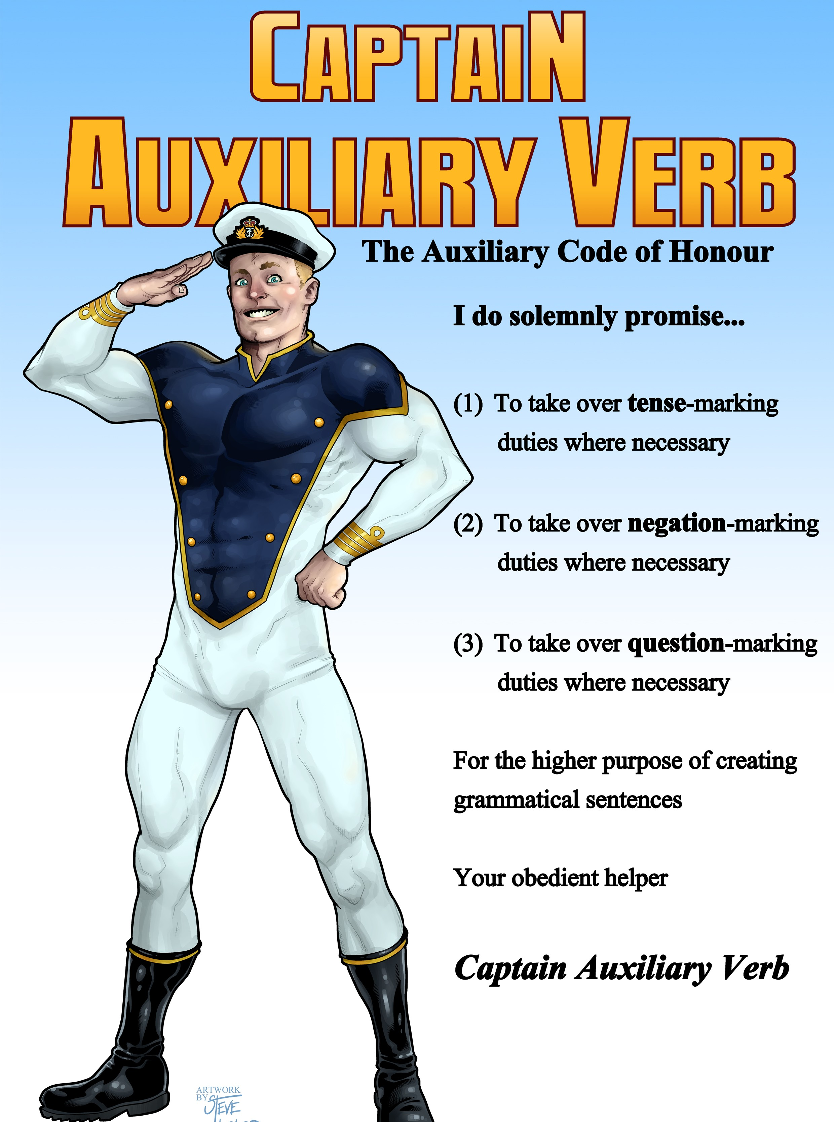
(2) Interrogative Mood
Mood, Mod, Voice
Nick Riches
Homework
Mood, Mod, Voice Mood
Types of mood, with examples
Mood in other languages
Declarative Mood
Interrogative Mood EXERCISE
Int errors DLD Ints in ASD
Exclamative mood
Imperative mood
Modality
The basics Getting tricky
Permission modals Will
Can
Semi-modals EXERCISE
Clinical relevance
Voice
The basics
Passive gets bad press! Lang.imp. popns
Homework
References
16 / 57

Slide 24
(2) Interrogative Mood
Mood, Mod, Voice
Nick Riches
Homework
Mood, Mod, Voice
Mood
Types of mood, with examples
Mood in other languages
Declarative Mood
Interrogative Mood EXERCISE
Int errors DLD Ints in ASD
Exclamative mood
Imperative mood
1. He has given the book to
X
Modality
The basics Getting tricky
Permission modals Will
Can
Semi-modals EXERCISE
Clinical relevance
Voice
The basics
Passive gets bad press! Lang.imp. popns
Homework
References
17 / 57

Slide 25
(2) Interrogative Mood
Mood, Mod, Voice
Nick Riches
Homework
Mood, Mod, Voice
Mood
Types of mood, with examples
Mood in other languages
Declarative Mood
Interrogative Mood EXERCISE
Int errors DLD Ints in ASD
Exclamative mood
Imperative mood
1. He has given the book to X
label
Who he has given the book to t ?
2.
Modality
The basics Getting tricky
Permission modals Will
Can
Semi-modals EXERCISE
Clinical relevance
Voice
The basics
Passive gets bad press! Lang.imp. popns
Homework
References
17 / 57

Slide 26
(2) Interrogative Mood
Mood, Mod, Voice
Nick Riches
Homework
Mood, Mod, Voice
Mood
Types of mood, with examples
Mood in other languages
Declarative Mood
Interrogative Mood EXERCISE
Int errors DLD Ints in ASD
Exclamative mood
Imperative mood
1. He has given the book to X
label
Who he has given the book to t ?
2.
label
Modality
The basics Getting tricky
Permission modals Will
Can
Semi-modals EXERCISE
Clinical relevance
he t given the book to t ?
label
Who
has
3.
Voice
The basics
Passive gets bad press! Lang.imp. popns
Homework
References
17 / 57

Slide 27
(2) Interrogative Mood
Mood, Mod, Voice
Nick Riches
Homework
Mood, Mod, Voice
Mood
Types of mood, with examples
Mood in other languages
Declarative Mood
Interrogative Mood EXERCISE
Int errors DLD Ints in ASD
Exclamative mood
Imperative mood
(13)
He escaped from jail [ with a crow bar ]
label
How
he escaped from jail t
(14)
Modality
The basics Getting tricky
Permission modals Will
Can
Semi-modals EXERCISE
Clinical relevance
(15) How
did
he escaped from jail
do-support
Voice
The basics
Passive gets bad press! Lang.imp. popns
Homework
References
18 / 57

Slide 28
(2) Interrogative Mood
Mood, Mod, Voice
Nick Riches
Homework
Mood, Mod, Voice
Mood
Types of mood, with examples
Mood in other languages
Declarative Mood
Interrogative Mood EXERCISE
Int errors DLD Ints in ASD
Exclamative mood
Imperative mood
And yes-no questions. . .
(16) Did he like the dinner?
do-support
Modality
The basics Getting tricky
Permission modals Will
Can
Semi-modals EXERCISE
Clinical relevance
label
Was
he t having a good time ?
(17)
Voice
The basics
Passive gets bad press! Lang.imp. popns
Homework
References
19 / 57

Slide 29
EXERCISE
Mood, Mod, Voice
Nick Riches
Homework
Mood, Mod, Voice
Mood
Types of mood, with examples
Mood in other languages
Declarative Mood
Interrogative Mood EXERCISE
Int errors DLD Ints in ASD
Exclamative mood
Imperative mood
Correct the following questions. Why are they wrong?
Would you like what to eat?
Who did eat all of the pies?
What he’s been doing lately?
Where he is?
Modality
The basics Getting tricky
Permission modals Will
Can
Semi-modals EXERCISE
Clinical relevance
Voice
The basics
Passive gets bad press! Lang.imp. popns
Homework
References
20 / 57

Slide 30
EXERCISE
Mood, Mod, Voice
Nick Riches
Homework
Mood, Mod, Voice
Correct the following questions. Why are they wrong?
Mood
Types of mood, with examples
Mood in other languages
Declarative Mood
Interrogative Mood EXERCISE
Int errors DLD Ints in ASD
Exclamative mood
Imperative mood
label
What
would you like t to eat ?
1.
Modality
The basics Getting tricky
Permission modals Will
Can
Semi-modals EXERCISE
Clinical relevance
Voice
The basics
Passive gets bad press! Lang.imp. popns
Homework
References
21 / 57

Slide 31
EXERCISE
Mood, Mod, Voice
Nick Riches
Homework
Mood, Mod, Voice
Correct the following questions. Why are they wrong?
Mood
Types of mood, with examples
Mood in other languages
Declarative Mood
Interrogative Mood EXERCISE
Int errors DLD Ints in ASD
Exclamative mood
Imperative mood
label
What would you like t to eat ?
1.
2. Who did eat ate all of the pies?
Modality
The basics Getting tricky
Permission modals Will
Can
Semi-modals EXERCISE
Clinical relevance
Voice
The basics
Passive gets bad press! Lang.imp. popns
Homework
References
21 / 57

Slide 32
EXERCISE
Mood, Mod, Voice
Nick Riches
Homework
Mood, Mod, Voice
Correct the following questions. Why are they wrong?
Mood
Types of mood, with examples
Mood in other languages
Declarative Mood
Interrogative Mood EXERCISE
Int errors DLD Ints in ASD
Exclamative mood
Imperative mood
label
What would you like t to eat ?
1.
2. Who did eat ate all of the pies?
label
Modality
The basics Getting tricky
Permission modals Will
Can
Semi-modals EXERCISE
Clinical relevance
What ’s he t been doing lately?
3.
Voice
The basics
Passive gets bad press! Lang.imp. popns
Homework
References
21 / 57

Slide 33
EXERCISE
Mood, Mod, Voice
Nick Riches
Homework
Mood, Mod, Voice
Correct the following questions. Why are they wrong?
Mood
Types of mood, with examples
Mood in other languages
Declarative Mood
Interrogative Mood EXERCISE
Int errors DLD Ints in ASD
Exclamative mood
Imperative mood
label
What would you like t to eat ?
1.
2. Who did eat ate all of the pies?
label
Modality
The basics Getting tricky
Permission modals Will
Can
Semi-modals EXERCISE
Clinical relevance
What ’s he t been doing lately?
3.
label
he t ?
Where
is
4.
Voice
The basics
Passive gets bad press! Lang.imp. popns
Homework
References
21 / 57

Slide 34
Interrogative errors in DLD
Mood, Mod, Voice
Nick Riches
Homework
Mood, Mod, Voice
Mood
Types of mood, with examples
Mood in other languages
Declarative Mood
Interrogative Mood EXERCISE
Int errors DLD Ints in ASD
Exclamative mood
Imperative mood
Van der Lely & Battell (2003)
Who Mrs Brown see?
What did they drank?
Which one did Mrs White wore a hat?
Modality
The basics Getting tricky
Permission modals Will
Can
Semi-modals EXERCISE
Clinical relevance
Voice
The basics
Passive gets bad press! Lang.imp. popns
Homework
References
22 / 57

Slide 35
Interrogative errors in DLD
Mood, Mod, Voice
Nick Riches
Homework
Mood, Mod, Voice
Mood
Types of mood, with examples
Mood in other languages
Declarative Mood
Interrogative Mood EXERCISE
Int errors DLD Ints in ASD
Exclamative mood
Imperative mood
label
you or you
label
Is
is
is
ain’t
my baby?
(18)
Modality
The basics Getting tricky
Permission modals Will
Can
Semi-modals EXERCISE
Clinical relevance
Voice
The basics
Passive gets bad press! Lang.imp. popns
Homework
References
23 / 57

Slide 36
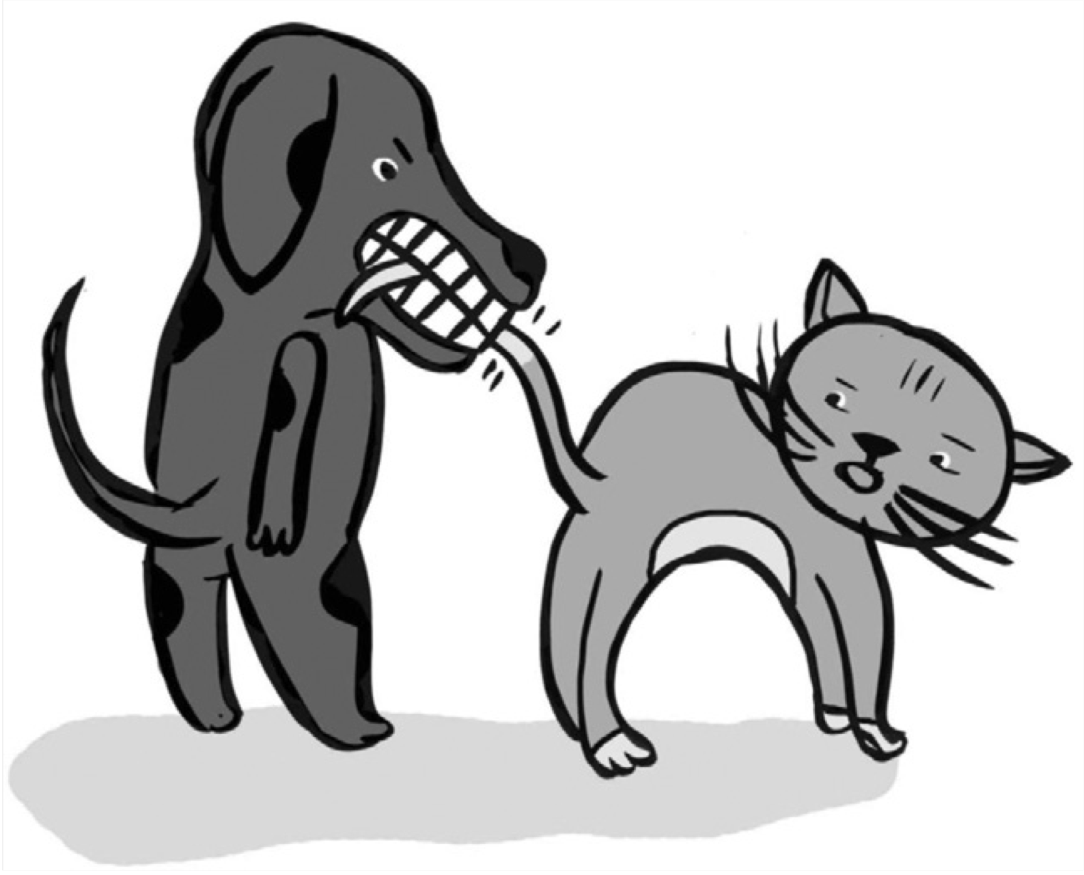
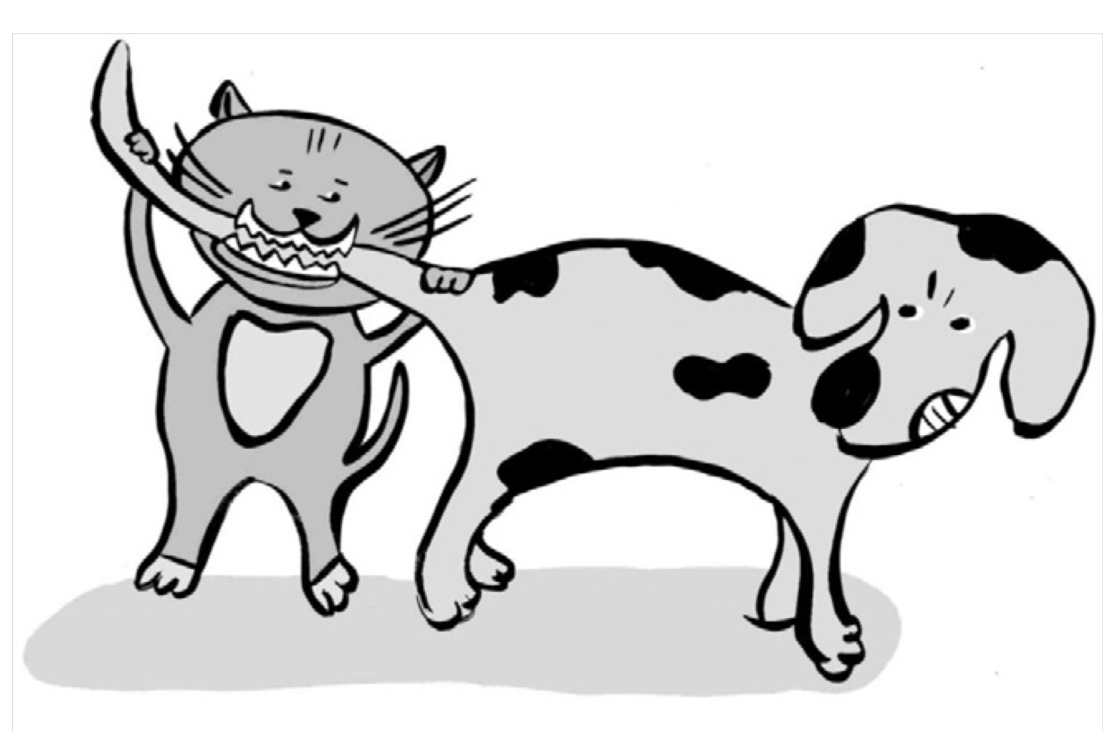
Interrogative errors in DLD
Mood, Mod, Voice
Nick Riches
Homework
Mood, Mod, Voice
Poor comprehension of Object questions (questions where ‘wh’ word refers to object) (Friedmann & Novogrodsky, 2011)
Mood
Types of mood, with examples
Mood in other languages
Declarative Mood
Interrogative Mood EXERCISE
Int errors DLD Ints in ASD
Exclamative mood
Imperative mood
Modality
The basics Getting tricky
Permission modals Will
Can
Semi-modals EXERCISE
Clinical relevance
Voice
The basics
Passive gets bad press! Lang.imp. popns
Homework
References
24 / 57

Slide 37
Interrogatives in Autism
Mood, Mod, Voice
Nick Riches
Homework
Mood, Mod, Voice
Mood
Types of mood, with examples
Mood in other languages
Declarative Mood
Interrogative Mood EXERCISE
Int errors DLD Ints in ASD
Exclamative mood
Imperative mood
Children with autism exhibit delayed use of questions (spontaneous usage)
A syntactic, or a pragmatic difficulty? (Jyotishi et al. 2017)
Modality
The basics Getting tricky
Permission modals Will
Can
Semi-modals EXERCISE
Clinical relevance
Voice
The basics
Passive gets bad press! Lang.imp. popns
Homework
References
25 / 57

Slide 38
(3) Exclamative mood
Mood, Mod, Voice
Nick Riches
Homework
Mood, Mod, Voice
Mood
Types of mood, with examples
Mood in other languages
Declarative Mood
Interrogative Mood EXERCISE
Int errors DLD Ints in ASD
Exclamative mood
Imperative mood
(19)
What
a nice guy!
label
it t awful!
Boy
was
Modality
The basics Getting tricky
Permission modals Will
Can
Semi-modals EXERCISE
Clinical relevance
(20)
Voice
The basics
Passive gets bad press! Lang.imp. popns
Homework
References
26 / 57

Slide 39
(3) Exclamative mood
Mood, Mod, Voice
Nick Riches
Homework
Mood, Mod, Voice
Mood
Types of mood, with examples
Mood in other languages
Declarative Mood
Interrogative Mood EXERCISE
Int errors DLD Ints in ASD
Exclamative mood
Imperative mood
Do exclamatives develop from interrogatives? (Goldberg, A. E., 2006)?
Can we use exclamatives to model grammatical properties of interrogatives?
Modality
The basics Getting tricky
Permission modals Will
Can
Semi-modals EXERCISE
Clinical relevance
Voice
The basics
Passive gets bad press! Lang.imp. popns
Homework
References
27 / 57

Slide 40
(3) Exclamative mood
Mood, Mod, Voice
Nick Riches
Homework
Mood, Mod, Voice
Mood
Types of mood, with examples
Mood in other languages
Declarative Mood
Interrogative Mood EXERCISE
Int errors DLD Ints in ASD
Exclamative mood
Imperative mood
Do exclamatives develop from interrogatives? (Goldberg, A. E., 2006)?
Can we use exclamatives to model grammatical properties of interrogatives?
label
Boy is he t fast !
Modality
The basics Getting tricky
Permission modals Will
Can
Semi-modals EXERCISE
Clinical relevance
label
label
Boy he t fast !
Is
he t fast ?
is
⇒
Voice
The basics
Passive gets bad press! Lang.imp. popns
Homework
References
27 / 57

Slide 41
(4) Imperative mood
Mood, Mod, Voice
Nick Riches
Homework
Mood, Mod, Voice
Mood
Types of mood, with examples
Mood in other languages
Declarative Mood
Interrogative Mood EXERCISE
Int errors DLD Ints in ASD
Exclamative mood
Imperative mood
(21)
(You) be quiet in the library!
(22)
(You) don’t drive so fast!
Modality
The basics Getting tricky
Permission modals Will
Can
Semi-modals EXERCISE
Clinical relevance
Voice
The basics
Passive gets bad press! Lang.imp. popns
Homework
References
28 / 57

Slide 42
(4) Imperative mood
Mood, Mod, Voice
Nick Riches
Homework
Mood, Mod, Voice
Mood
Types of mood, with examples
Mood in other languages
Declarative Mood
Interrogative Mood EXERCISE
Int errors DLD Ints in ASD
Exclamative mood
Imperative mood
NB unusual negative:
Don’t go!
He decided not to go to the party
Modality
The basics Getting tricky
Permission modals Will
Can
Semi-modals EXERCISE
Clinical relevance
Voice
The basics
Passive gets bad press! Lang.imp. popns
Homework
References
29 / 57

Slide 43
Mood, Mod, Voice
Nick Riches
Homework
Homework
Mood, modality and voice
Mood, Mod, Voice
Mood
Types of mood, with examples
Mood in other languages
Declarative Mood
Interrogative Mood EXERCISE
Int errors DLD Ints in ASD
Exclamative mood
Imperative mood
Mood
Modality
Voice
Modality
The basics Getting tricky
Permission modals Will
Can
Semi-modals EXERCISE
Clinical relevance
Homework References
Voice
The basics
Passive gets bad press! Lang.imp. popns
Homework
References
29 / 57

Slide 44
The basics
Mood, Mod, Voice
Nick Riches
Homework
Mood, Mod, Voice
Mood
Types of mood, with examples
Mood in other languages
Declarative Mood
Interrogative Mood EXERCISE
Int errors DLD Ints in ASD
Exclamative mood
Imperative mood
Semantics: concepts of OBLIGATION (‘deontic’ modality) and LIKELIHOOD (‘epistemic’ modality)
Syntax: Often expressed using modal auxiliary verbs, e.g.
must, should.
Modality
The basics Getting tricky
Permission modals Will
Can
Semi-modals EXERCISE
Clinical relevance
Voice
The basics
Passive gets bad press! Lang.imp. popns
Homework
References
30 / 57

Slide 45
The basics
Mood, Mod, Voice
Nick Riches
Homework
Mood, Mod, Voice
Mood
Types of mood, with examples
Mood in other languages
Declarative Mood
Interrogative Mood EXERCISE
Int errors DLD Ints in ASD
Exclamative mood
Imperative mood
(25)
You must arrive on time (DEONTIC MODALITY)
(26)
Jack must be running late (EPISTEMIC MODALITY)
(27)
You shouldn’t smoke (DEONTIC MODALITY)
Modality
The basics Getting tricky
Permission modals Will
Can
Semi-modals EXERCISE
Clinical relevance
(28)
He shouldn’t be long now (EPISTEMIC MODALITY)
Voice
The basics
Passive gets bad press! Lang.imp. popns
Homework
References
31 / 57

Slide 46
The basics
Mood, Mod, Voice
Nick Riches
Homework
4 important grammatical properties
Mood, Mod, Voice
Mood
Types of mood, with examples
Mood in other languages
Declarative Mood
Interrogative Mood EXERCISE
Int errors DLD Ints in ASD
Exclamative mood
Imperative mood
1. They don’t inflect for tense
e.g. * She musted arrive on time
2. They don’t inflect for agreement
e.g. * She musts arrive on time
3. They are followed by the inifinitive form (without “to”)
e.g. She must arrive on time.
4. They invert to make questions, e.g.
label
Should I t bring a packed lunch?
Modality
The basics Getting tricky
Permission modals Will
Can
Semi-modals EXERCISE
Clinical relevance
Voice
The basics
Passive gets bad press! Lang.imp. popns
Homework
References
32 / 57

Slide 47
Getting tricky
Mood, Mod, Voice
Nick Riches
Homework
Mood, Mod, Voice
Mood
Types of mood, with examples
Mood in other languages
Declarative Mood
Interrogative Mood EXERCISE
Int errors DLD Ints in ASD
Exclamative mood
Imperative mood
Permission modals, e.g.
You may not have some more
May I have some more please?
Deontic modals in disguise, e.g.
Modality
The basics Getting tricky
Permission modals Will
Can
Semi-modals EXERCISE
Clinical relevance
You may have some more ⇒ It’s NOT the case that you
MUSTN’T have some more
Voice
The basics
Passive gets bad press! Lang.imp. popns
Homework
References
33 / 57

Slide 48
Getting tricky
Mood, Mod, Voice
Nick Riches
Homework
Mood, Mod, Voice
Mood
Types of mood, with examples
Mood in other languages
Declarative Mood
Interrogative Mood EXERCISE
Int errors DLD Ints in ASD
Exclamative mood
Imperative mood
Will has modal syntactic characteristics, e.g. no agreement (He wills do it)
But rarely expresses modal meaning, e.g. You will do it now!
Modality
The basics Getting tricky
Permission modals Will
Can
Semi-modals EXERCISE
Clinical relevance
Voice
The basics
Passive gets bad press! Lang.imp. popns
Homework
References
34 / 57

Slide 49
Getting tricky
Mood, Mod, Voice
Nick Riches
Homework
Mood, Mod, Voice
Mood
Types of mood, with examples
Mood in other languages
Declarative Mood
Interrogative Mood EXERCISE
Int errors DLD Ints in ASD
Exclamative mood
Imperative mood
Can is often, but not always, used as a modal verb, e.g.
You can’t smoke here (DEONTIC MODALITY)
You can’t be serious (EPISTEMIC MODALITY)
Modality
The basics Getting tricky
Permission modals Will
Can
Semi-modals EXERCISE
Clinical relevance
(33)
I can’t do this homework (ABILITY = NON-MODAL MEANING).
Voice
The basics
Passive gets bad press! Lang.imp. popns
Homework
References
35 / 57

Slide 50
Getting tricky
Mood, Mod, Voice
Nick Riches
Homework
Have to and Need to are semi-modals
Express modal concepts (OBLIGATION), but do not exhibit the typical grammatical properties of modal verbs
need to, have to;
Mood, Mod, Voice
Mood
Types of mood, with examples
Mood in other languages
Declarative Mood
Interrogative Mood EXERCISE
Int errors DLD Ints in ASD
Exclamative mood
Imperative mood
They inflect for tense
He had to/needed to work harder
They inflect for agreement
He has to/needs to work harder
Questions use do-support instead of inversion
Do I have to/need to work harder?
Modality
The basics Getting tricky
Permission modals Will
Can
Semi-modals EXERCISE
Clinical relevance
Voice
The basics
Passive gets bad press! Lang.imp. popns
Homework
References
36 / 57

Slide 51
Getting tricky
Mood, Mod, Voice
Nick Riches
Homework
Mood, Mod, Voice
Mood
Types of mood, with examples
Mood in other languages
Declarative Mood
Interrogative Mood EXERCISE
Int errors DLD Ints in ASD
Exclamative mood
Imperative mood
Because they inflect for tense, they are very useful for expressing modal concepts in the past, e.g.
Yesterday I had to get up early.
*Yesterday I musted get up early.
Modality
The basics Getting tricky
Permission modals Will
Can
Semi-modals EXERCISE
Clinical relevance
Voice
The basics
Passive gets bad press! Lang.imp. popns
Homework
References
37 / 57

Slide 52
EXERCISE
Mood, Mod, Voice
Nick Riches
Homework
Mood, Mod, Voice
Rewrite the following sentences using modal verbs
Mood
Types of mood, with examples
Mood in other languages
Declarative Mood
Interrogative Mood EXERCISE
Int errors DLD Ints in ASD
Exclamative mood
Imperative mood
It’s obligatory for students to arrive on time
It’s likely that it was the butler who committed the murder
It’s advisable for you to avoid alcohol while on these tablets
Is it obligatory for Jack to wear a suit to work?
(Doorbell rings) That’s unlikely to be Mary.
We were obliged to wear a uniform at my school.
Modality
The basics Getting tricky
Permission modals Will
Can
Semi-modals EXERCISE
Clinical relevance
Voice
The basics
Passive gets bad press! Lang.imp. popns
Homework
References
38 / 57

Slide 53
EXERCISE
Mood, Mod, Voice
Nick Riches
1. It’s obligatory for students to arrive on time
Homework
Mood, Mod, Voice
Mood
Types of mood, with examples
Mood in other languages
Declarative Mood
Interrogative Mood EXERCISE
Int errors DLD Ints in ASD
Exclamative mood
Imperative mood
Modality
The basics Getting tricky
Permission modals Will
Can
Semi-modals EXERCISE
Clinical relevance
Voice
The basics
Passive gets bad press! Lang.imp. popns
Homework
References
39 / 57

Slide 54
EXERCISE
Mood, Mod, Voice
Nick Riches
1. It’s obligatory for students to arrive on time ⇒
Homework
Students have to / must arrive on time.
Mood, Mod, Voice
Mood
Types of mood, with examples
Mood in other languages
Declarative Mood
Interrogative Mood EXERCISE
Int errors DLD Ints in ASD
Exclamative mood
Imperative mood
Modality
The basics Getting tricky
Permission modals Will
Can
Semi-modals EXERCISE
Clinical relevance
Voice
The basics
Passive gets bad press! Lang.imp. popns
Homework
References
39 / 57

Slide 55
EXERCISE
Mood, Mod, Voice
Nick Riches
1. It’s obligatory for students to arrive on time ⇒
Homework
Students have to / must arrive on time.
2. It’s likely that it was the butler who committed the murder
Mood, Mod, Voice
Mood
Types of mood, with examples
Mood in other languages
Declarative Mood
Interrogative Mood EXERCISE
Int errors DLD Ints in ASD
Exclamative mood
Imperative mood
Modality
The basics Getting tricky
Permission modals Will
Can
Semi-modals EXERCISE
Clinical relevance
Voice
The basics
Passive gets bad press! Lang.imp. popns
Homework
References
39 / 57

Slide 56
EXERCISE
Mood, Mod, Voice
Nick Riches
1. It’s obligatory for students to arrive on time ⇒
Homework
Students have to / must arrive on time.
2. It’s likely that it was the butler who committed the
Mood, Mod, Voice
Mood
Types of mood, with examples
Mood in other languages
Declarative Mood
Interrogative Mood EXERCISE
Int errors DLD Ints in ASD
Exclamative mood
Imperative mood
murder ⇒
The butler must have committed the murder.
Modality
The basics Getting tricky
Permission modals Will
Can
Semi-modals EXERCISE
Clinical relevance
Voice
The basics
Passive gets bad press! Lang.imp. popns
Homework
References
39 / 57

Slide 57
EXERCISE
Mood, Mod, Voice
Nick Riches
1. It’s obligatory for students to arrive on time ⇒
Homework
Students have to / must arrive on time.
2. It’s likely that it was the butler who committed the
Mood, Mod, Voice
Mood
Types of mood, with examples
Mood in other languages
Declarative Mood
Interrogative Mood EXERCISE
Int errors DLD Ints in ASD
Exclamative mood
Imperative mood
murder ⇒
The butler must have committed the murder.
3. It’s advisable for you to avoid alcohol while on these tablets
Modality
The basics Getting tricky
Permission modals Will
Can
Semi-modals EXERCISE
Clinical relevance
Voice
The basics
Passive gets bad press! Lang.imp. popns
Homework
References
39 / 57

Slide 58
EXERCISE
Mood, Mod, Voice
Nick Riches
1. It’s obligatory for students to arrive on time ⇒
Homework
Students have to / must arrive on time.
2. It’s likely that it was the butler who committed the
Mood, Mod, Voice
Mood
Types of mood, with examples
Mood in other languages
Declarative Mood
Interrogative Mood EXERCISE
Int errors DLD Ints in ASD
Exclamative mood
Imperative mood
murder ⇒
The butler must have committed the murder.
3. It’s advisable for you to avoid alcohol while on these
tablets ⇒
You should avoid alcohol while on these tablets
Modality
The basics Getting tricky
Permission modals Will
Can
Semi-modals EXERCISE
Clinical relevance
Voice
The basics
Passive gets bad press! Lang.imp. popns
Homework
References
39 / 57

Slide 59
EXERCISE
Mood, Mod, Voice
Nick Riches
1. It’s obligatory for students to arrive on time ⇒
Homework
Students have to / must arrive on time.
2. It’s likely that it was the butler who committed the
Mood, Mod, Voice
Mood
Types of mood, with examples
Mood in other languages
Declarative Mood
Interrogative Mood EXERCISE
Int errors DLD Ints in ASD
Exclamative mood
Imperative mood
murder ⇒
The butler must have committed the murder.
3. It’s advisable for you to avoid alcohol while on these
tablets ⇒
You should avoid alcohol while on these tablets
Modality
The basics Getting tricky
Permission modals Will
Can
Semi-modals EXERCISE
Clinical relevance
4. Is it obligatory for Jack to wear a suit to work?
Voice
The basics
Passive gets bad press! Lang.imp. popns
Homework
References
39 / 57

Slide 60
EXERCISE
Mood, Mod, Voice
Nick Riches
1. It’s obligatory for students to arrive on time ⇒
Homework
Students have to / must arrive on time.
2. It’s likely that it was the butler who committed the
Mood, Mod, Voice
Mood
Types of mood, with examples
Mood in other languages
Declarative Mood
Interrogative Mood EXERCISE
Int errors DLD Ints in ASD
Exclamative mood
Imperative mood
murder ⇒
The butler must have committed the murder.
3. It’s advisable for you to avoid alcohol while on these
tablets ⇒
You should avoid alcohol while on these tablets
Modality
The basics Getting tricky
Permission modals Will
Can
Semi-modals EXERCISE
Clinical relevance
4. Is it obligatory for Jack to wear a suit to work? ⇒
Does Jack have to wear a suit?
Must Jack wear a suit?
Voice
The basics
Passive gets bad press! Lang.imp. popns
Homework
References
39 / 57

Slide 61
EXERCISE
Mood, Mod, Voice
Nick Riches
1. It’s obligatory for students to arrive on time ⇒
Homework
Students have to / must arrive on time.
2. It’s likely that it was the butler who committed the
Mood, Mod, Voice
Mood
Types of mood, with examples
Mood in other languages
Declarative Mood
Interrogative Mood EXERCISE
Int errors DLD Ints in ASD
Exclamative mood
Imperative mood
murder ⇒
The butler must have committed the murder.
3. It’s advisable for you to avoid alcohol while on these
tablets ⇒
You should avoid alcohol while on these tablets
Modality
The basics Getting tricky
Permission modals Will
Can
Semi-modals EXERCISE
Clinical relevance
4. Is it obligatory for Jack to wear a suit to work? ⇒
Does Jack have to wear a suit?
Must Jack wear a suit?
5. (Doorbell rings) That’s unlikely to be Mary.
Voice
The basics
Passive gets bad press! Lang.imp. popns
Homework
References
39 / 57

Slide 62
EXERCISE
Mood, Mod, Voice
Nick Riches
1. It’s obligatory for students to arrive on time ⇒
Homework
Students have to / must arrive on time.
2. It’s likely that it was the butler who committed the
Mood, Mod, Voice
Mood
Types of mood, with examples
Mood in other languages
Declarative Mood
Interrogative Mood EXERCISE
Int errors DLD Ints in ASD
Exclamative mood
Imperative mood
murder ⇒
The butler must have committed the murder.
3. It’s advisable for you to avoid alcohol while on these
tablets ⇒
You should avoid alcohol while on these tablets
Modality
The basics Getting tricky
Permission modals Will
Can
Semi-modals EXERCISE
Clinical relevance
4. Is it obligatory for Jack to wear a suit to work? ⇒
Does Jack have to wear a suit?
Must Jack wear a suit?
5. (Doorbell rings) That’s unlikely to be Mary. ⇒
That can’t be Mary!
Voice
The basics
Passive gets bad press! Lang.imp. popns
Homework
References
39 / 57

Slide 63
EXERCISE
Mood, Mod, Voice
Nick Riches
1. It’s obligatory for students to arrive on time ⇒
Homework
Students have to / must arrive on time.
2. It’s likely that it was the butler who committed the
Mood, Mod, Voice
Mood
Types of mood, with examples
Mood in other languages
Declarative Mood
Interrogative Mood EXERCISE
Int errors DLD Ints in ASD
Exclamative mood
Imperative mood
murder ⇒
The butler must have committed the murder.
3. It’s advisable for you to avoid alcohol while on these
tablets ⇒
You should avoid alcohol while on these tablets
Modality
The basics Getting tricky
Permission modals Will
Can
Semi-modals EXERCISE
Clinical relevance
4. Is it obligatory for Jack to wear a suit to work? ⇒
Does Jack have to wear a suit?
Must Jack wear a suit?
5. (Doorbell rings) That’s unlikely to be Mary. ⇒
That can’t be Mary!
6. We were obliged to wear a uniform at my school.
Voice
The basics
Passive gets bad press! Lang.imp. popns
Homework
References
39 / 57

Slide 64
EXERCISE
Mood, Mod, Voice
Nick Riches
1. It’s obligatory for students to arrive on time ⇒
Homework
Students have to / must arrive on time.
2. It’s likely that it was the butler who committed the
Mood, Mod, Voice
Mood
Types of mood, with examples
Mood in other languages
Declarative Mood
Interrogative Mood EXERCISE
Int errors DLD Ints in ASD
Exclamative mood
Imperative mood
murder ⇒
The butler must have committed the murder.
3. It’s advisable for you to avoid alcohol while on these
tablets ⇒
You should avoid alcohol while on these tablets
Modality
The basics Getting tricky
Permission modals Will
Can
Semi-modals EXERCISE
Clinical relevance
4. Is it obligatory for Jack to wear a suit to work? ⇒
Does Jack have to wear a suit?
Must Jack wear a suit?
5. (Doorbell rings) That’s unlikely to be Mary. ⇒
That can’t be Mary!
Voice
The basics
Passive gets bad press! Lang.imp. popns
6. We were obliged to wear a uniform at my school. ⇒
We had to wear a uniform at my school.
Homework
References
39 / 57

Slide 65
Clinical relevance
Mood, Mod, Voice
Nick Riches
Homework
Mood, Mod, Voice
Mood
Types of mood, with examples
Mood in other languages
Declarative Mood
Interrogative Mood EXERCISE
Int errors DLD Ints in ASD
Exclamative mood
Imperative mood
Presumably language-impaired children have difficulties with syntactic characteristics of modals (e.g. negation and questions)
Papafragou (1998) argues that development of epistemic
Modality
The basics Getting tricky
Permission modals Will
Can
Semi-modals EXERCISE
Clinical relevance
modals is linked to theory of mind ⇒ likely to be delayed in
autism.
Voice
The basics
Passive gets bad press! Lang.imp. popns
Homework
References
40 / 57

Slide 66
Mood, Mod, Voice
Nick Riches
Homework
Homework
Mood, modality and voice
Mood, Mod, Voice
Mood
Types of mood, with examples
Mood in other languages
Declarative Mood
Interrogative Mood EXERCISE
Int errors DLD Ints in ASD
Exclamative mood
Imperative mood
Mood
Modality
Voice
Modality
The basics Getting tricky
Permission modals Will
Can
Semi-modals EXERCISE
Clinical relevance
Homework References
Voice
The basics
Passive gets bad press! Lang.imp. popns
Homework
References
40 / 57

Slide 67
Active versus passive voices - the basics
Mood, Mod, Voice
Nick Riches
Homework
Mood, Mod, Voice
Mood
Types of mood, with examples
Mood in other languages
Declarative Mood
Interrogative Mood EXERCISE
Int errors DLD Ints in ASD
Exclamative mood
Imperative mood
Have you watched “The Walking Dead”?
It’s one of my favourite series.
It’s about a group of surviviors fighting zombies in an apocalyptic wasteland.
It’s really quite gripping.
Modality
The basics Getting tricky
Permission modals Will
Can
Semi-modals EXERCISE
Clinical relevance
5. It’s made by an American Channel called AMC
6. The pilot episode was directed by Frank Darabont,
who directed the Shawshank Redemption.
Voice
The basics
Passive gets bad press! Lang.imp. popns
Homework
References
41 / 57

Slide 68
Active versus passive voices - the basics
Mood, Mod, Voice
Nick Riches
Homework
Mood, Mod, Voice
Mood
Types of mood, with examples
Mood in other languages
Declarative Mood
Interrogative Mood EXERCISE
Int errors DLD Ints in ASD
Exclamative mood
Imperative mood
(36) The pilot was directed by F. Darabont S Aux. be Perf. form By-phrase
THE PASSIVE VOICE
Modality
The basics Getting tricky
Permission modals Will
Can
Semi-modals EXERCISE
Clinical relevance
Voice
The basics
Passive gets bad press! Lang.imp. popns
Homework
References
42 / 57

Slide 69
Active versus passive voices - the basics
Mood, Mod, Voice
Nick Riches
Homework
Mood, Mod, Voice
Mood
Types of mood, with examples
Mood in other languages
Declarative Mood
Interrogative Mood EXERCISE
Int errors DLD Ints in ASD
Exclamative mood
Imperative mood
label
The pilot episode was directed t by F. Darabont
(37)
Modality
The basics Getting tricky
Permission modals Will
Can
Semi-modals EXERCISE
Clinical relevance
Turns a non-subject into a subject.
Voice
The basics
Passive gets bad press! Lang.imp. popns
Homework
References
43 / 57

Slide 70
Active versus passive voices - the basics
Mood, Mod, Voice
Nick Riches
Homework
Mood, Mod, Voice
Mood
Types of mood, with examples
Mood in other languages
Declarative Mood
Interrogative Mood EXERCISE
Int errors DLD Ints in ASD
Exclamative mood
Imperative mood
label
Food
was given t to all the refugees
(38)
label
were given t food
Modality
The basics Getting tricky
Permission modals Will
Can
Semi-modals EXERCISE
Clinical relevance
(39)
All the refugees
Voice
The basics
Passive gets bad press! Lang.imp. popns
Homework
References
44 / 57

Slide 71
Active versus passive voices - the basics
Mood, Mod, Voice
Nick Riches
Homework
Mood, Mod, Voice
Mood
Types of mood, with examples
Mood in other languages
Declarative Mood
Interrogative Mood EXERCISE
Int errors DLD Ints in ASD
Exclamative mood
Imperative mood
Passives can sometimes have two past participles in a row:
(40) She has been given an award
PRES. PERF. PASSIVE
Modality
The basics Getting tricky
Permission modals Will
Can
Semi-modals EXERCISE
Clinical relevance
Voice
The basics
Passive gets bad press! Lang.imp. popns
Homework
References
45 / 57

Slide 72
Active versus passive voices - the basics
Mood, Mod, Voice
Nick Riches
Homework
Mood, Mod, Voice
Mood
Types of mood, with examples
Mood in other languages
Declarative Mood
Interrogative Mood EXERCISE
Int errors DLD Ints in ASD
Exclamative mood
Imperative mood
Subject and object complements cannot be passivised
label
He was elected t captain of the team
(41)
Modality
The basics Getting tricky
Permission modals Will
Can
Semi-modals EXERCISE
Clinical relevance
label
Captain of the team
was elected him t
(42) *
Voice
The basics
Passive gets bad press! Lang.imp. popns
Homework
References
46 / 57

Slide 73
Active versus passive voices - the basics
Mood, Mod, Voice
Nick Riches
Homework
Mood, Mod, Voice
Mood
Types of mood, with examples
Mood in other languages
Declarative Mood
Interrogative Mood EXERCISE
Int errors DLD Ints in ASD
Exclamative mood
Imperative mood
The ULTIMATE test for the passive!!! The ‘hedgehog test’ (Frances Avery) Can you add ‘by hedgehogs’?
Modality
The basics Getting tricky
Permission modals Will
Can
Semi-modals EXERCISE
Clinical relevance
Voice
The basics
Passive gets bad press! Lang.imp. popns
Homework
References
47 / 57

Slide 74
Active versus passive voices - the basics
Mood, Mod, Voice
Nick Riches
Homework
Mood, Mod, Voice
Mood
Types of mood, with examples
Mood in other languages
Declarative Mood
Interrogative Mood EXERCISE
Int errors DLD Ints in ASD
Exclamative mood
Imperative mood
(43)
Food was given to all the refugees
.
(44)
All of the food had been eaten
(45)
*He’s been working for ten hours
Modality
The basics Getting tricky
Permission modals Will
Can
Semi-modals EXERCISE
Clinical relevance
Voice
The basics
Passive gets bad press! Lang.imp. popns
Homework
References
48 / 57

Slide 75
Active versus passive voices - the basics
Mood, Mod, Voice
Nick Riches
Homework
Mood, Mod, Voice
Mood
Types of mood, with examples
Mood in other languages
Declarative Mood
Interrogative Mood EXERCISE
Int errors DLD Ints in ASD
Exclamative mood
Imperative mood
(43)
Food was given to all the refugees by hedgehogs.
(44)
All of the food had been eaten
(45)
*He’s been working for ten hours
Modality
The basics Getting tricky
Permission modals Will
Can
Semi-modals EXERCISE
Clinical relevance
Voice
The basics
Passive gets bad press! Lang.imp. popns
Homework
References
48 / 57

Slide 76
Active versus passive voices - the basics
Mood, Mod, Voice
Nick Riches
Homework
Mood, Mod, Voice
Mood
Types of mood, with examples
Mood in other languages
Declarative Mood
Interrogative Mood EXERCISE
Int errors DLD Ints in ASD
Exclamative mood
Imperative mood
(43)
Food was given to all the refugees by hedgehogs.
(44)
All of the food had been eaten by hedgehogs
(45)
*He’s been working for ten hours
Modality
The basics Getting tricky
Permission modals Will
Can
Semi-modals EXERCISE
Clinical relevance
Voice
The basics
Passive gets bad press! Lang.imp. popns
Homework
References
48 / 57

Slide 77
Active versus passive voices - the basics
Mood, Mod, Voice
Nick Riches
Homework
Mood, Mod, Voice
Mood
Types of mood, with examples
Mood in other languages
Declarative Mood
Interrogative Mood EXERCISE
Int errors DLD Ints in ASD
Exclamative mood
Imperative mood
(43)
Food was given to all the refugees by hedgehogs.
(44)
All of the food had been eaten by hedgehogs
(45)
*He’s been working for ten hours by hedgehogs
Modality
The basics Getting tricky
Permission modals Will
Can
Semi-modals EXERCISE
Clinical relevance
Voice
The basics
Passive gets bad press! Lang.imp. popns
Homework
References
48 / 57

Slide 78
The passive gets a bad press!
Mood, Mod, Voice
Nick Riches
Homework
Use of the passive is often criticised, and many style manuals, e.g. Strunk and White, “The Elements of Style”
Mood, Mod, Voice
Mood
Types of mood, with examples
Mood in other languages
Declarative Mood
Interrogative Mood EXERCISE
Int errors DLD Ints in ASD
Exclamative mood
Imperative mood
Modality
The basics Getting tricky
Permission modals Will
Can
Semi-modals EXERCISE
Clinical relevance
Voice
The basics
Passive gets bad press! Lang.imp. popns
Homework
References
49 / 57

Slide 79
The passive gets a bad press!
Mood, Mod, Voice
Nick Riches
Homework
Use of the passive is often criticised, and many style manuals, e.g. Strunk and White, “The Elements of Style” It is ‘dishonest’ because it hides agency
Mood, Mod, Voice
Mood
Types of mood, with examples
Mood in other languages
Declarative Mood
Interrogative Mood EXERCISE
Int errors DLD Ints in ASD
Exclamative mood
Imperative mood
(46)
TEENAGER: Mum, I invited a few friends around, and unfortunately the TV was broken . . .
(47)
The miners were arrested
Modality
The basics Getting tricky
Permission modals Will
Can
Semi-modals EXERCISE
Clinical relevance
Voice
The basics
Passive gets bad press! Lang.imp. popns
Homework
References
49 / 57

Slide 80

The passive gets a bad press!
Mood, Mod, Voice
Nick Riches
Homework
Use of the passive is often criticised, and many style manuals, e.g. Strunk and White, “The Elements of Style” It is ‘dishonest’ because it hides agency
Mood, Mod, Voice
Mood
Types of mood, with examples
Mood in other languages
Declarative Mood
Interrogative Mood EXERCISE
Int errors DLD Ints in ASD
Exclamative mood
Imperative mood
(46)
TEENAGER: Mum, I invited a few friends around, and unfortunately the TV was broken . . .
(47)
The miners were arrested
Modality
The basics Getting tricky
Permission modals Will
Can
Semi-modals EXERCISE
Clinical relevance
‘50 years of stupid grammar advice’, by Geoff Pullum.
Voice
The basics
Passive gets bad press! Lang.imp. popns
Homework
References
49 / 57

Slide 81
The passive gets a bad press!
Mood, Mod, Voice
Nick Riches
Homework
Have you watched “The Walking Dead”?
It’s one of my favourite series.
It’s about a group of surviviors fighting zombies in an apocalyptic wasteland.
It’s really quite gripping.
Mood, Mod, Voice
Mood
Types of mood, with examples
Mood in other languages
Declarative Mood
Interrogative Mood EXERCISE
Int errors DLD Ints in ASD
Exclamative mood
Imperative mood
5. It’s made by an American Channel called AMC
Modality
The basics Getting tricky
Permission modals Will
Can
Semi-modals EXERCISE
Clinical relevance
?? AMC made it
6. The pilot episode was directed by Frank Darabont,
who directed the Shawshank Redemption.
?? Frank Darabont, who directed the Shawshank Reemption made the pilot episode.
Voice
The basics
Passive gets bad press! Lang.imp. popns
Homework
References
50 / 57

Slide 82
The passive gets a bad press!
Mood, Mod, Voice
Nick Riches
Homework
Mood, Mod, Voice
Mood
Types of mood, with examples
Mood in other languages
Declarative Mood
Interrogative Mood EXERCISE
Int errors DLD Ints in ASD
Exclamative mood
Imperative mood
The passive voice turns a non-subject into a topic It therefore promotes coherent discourse.
Modality
The basics Getting tricky
Permission modals Will
Can
Semi-modals EXERCISE
Clinical relevance
Voice
The basics
Passive gets bad press! Lang.imp. popns
Homework
References
51 / 57

Slide 83
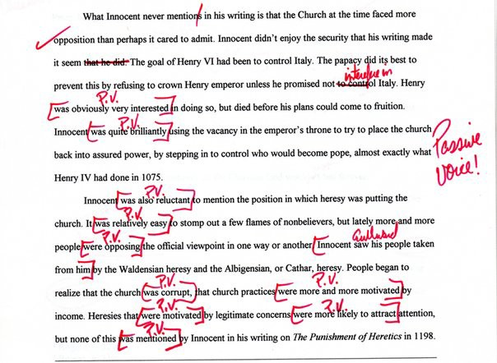
The passive gets a bad press!
Mood, Mod, Voice
Nick Riches
Homework
Mood, Mod, Voice Mood
Types of mood, with examples
Mood in other languages
Declarative Mood
Interrogative Mood EXERCISE
Int errors DLD Ints in ASD
Exclamative mood
Imperative mood
Modality
The basics Getting tricky
Permission modals Will
Can
Semi-modals EXERCISE
Clinical relevance
Voice
The basics
Passive gets bad press! Lang.imp. popns
Homework
References
52 / 57

Slide 84
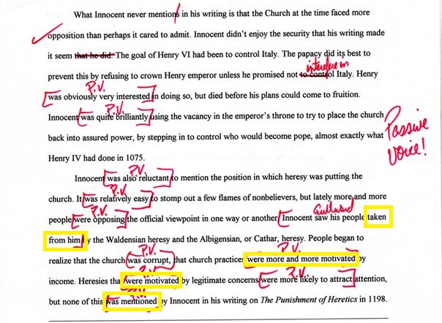
The passive gets a bad press!
Mood, Mod, Voice
Nick Riches
Homework
Mood, Mod, Voice Mood
Types of mood, with examples
Mood in other languages
Declarative Mood
Interrogative Mood EXERCISE
Int errors DLD Ints in ASD
Exclamative mood
Imperative mood
Modality
The basics Getting tricky
Permission modals Will
Can
Semi-modals EXERCISE
Clinical relevance
Voice
The basics
Passive gets bad press! Lang.imp. popns
Homework
References
53 / 57

Slide 85
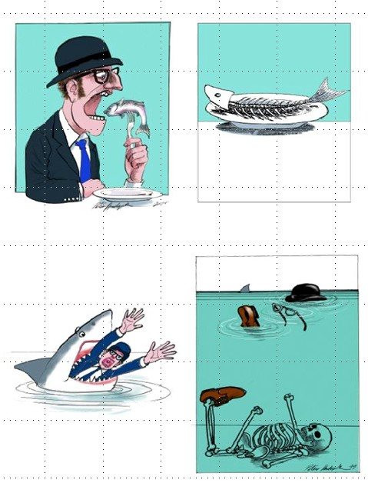
The passive in language-impaired populations
Mood, Mod, Voice
Nick Riches
Individuals with developmental/acquired language impairments have great difficulties producing the passive (Van der Lely, 1996)
Homework
Mood, Mod, Voice
Mood
Types of mood, with examples
Mood in other languages
Declarative Mood
Interrogative Mood EXERCISE
Int errors DLD Ints in ASD
Exclamative mood
Imperative mood
Modality
The basics Getting tricky
Permission modals Will
Can
Semi-modals EXERCISE
Clinical relevance
Voice
The basics
Passive gets bad press! Lang.imp. popns
Homework
References
54 / 57

Slide 86


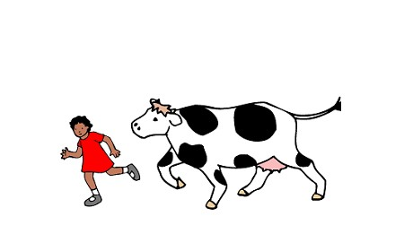
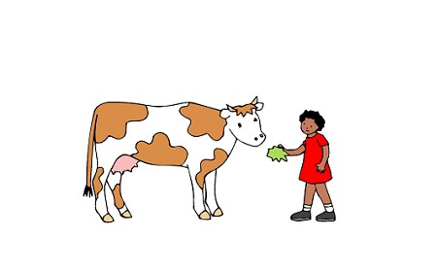
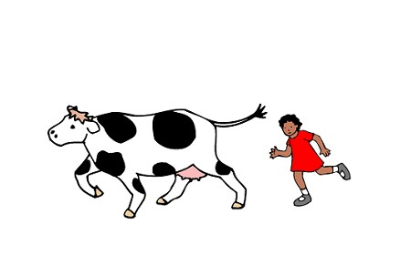
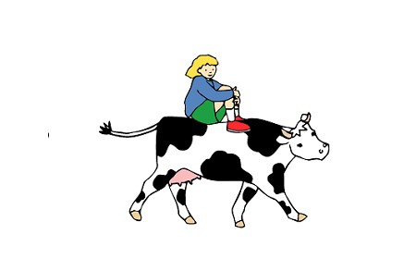
The passive in language-impaired populations
Mood, Mod, Voice
Nick Riches
You will find that many assessments of both production and comprehension (e.g. CELF recalling sentences, or TROG comprehension task) employ the passive.
‘The cow is chased by the girl’
Homework
Mood, Mod, Voice
Mood
Types of mood, with examples
Mood in other languages
Declarative Mood
Interrogative Mood EXERCISE
Int errors DLD Ints in ASD
Exclamative mood
Imperative mood
K1
Modality
The basics Getting tricky
Permission modals Will
Can
Semi-modals EXERCISE
Clinical relevance
Voice
The basics
Passive gets bad press! Lang.imp. popns
Homework
References
55 / 57

Slide 87
Mood, Mod, Voice
Nick Riches
Homework
Homework
Mood, modality and voice
Mood, Mod, Voice
Mood
Types of mood, with examples
Mood in other languages
Declarative Mood
Interrogative Mood EXERCISE
Int errors DLD Ints in ASD
Exclamative mood
Imperative mood
Mood
Modality
Voice
Modality
The basics Getting tricky
Permission modals Will
Can
Semi-modals EXERCISE
Clinical relevance
Homework References
Voice
The basics
Passive gets bad press! Lang.imp. popns
Homework
References
55 / 57

Slide 88
Mood, Mod, Voice
Nick Riches
Homework
Mood, Mod, Voice
Mood
Types of mood, with examples
Mood in other languages
Declarative Mood
Interrogative Mood EXERCISE
Int errors DLD Ints in ASD
Exclamative mood
Imperative mood
The following sentence is actually grammatical
(48) The horse raced past the barn fell
Can you create a discourse context where the sentence makes sense.
Modality
The basics Getting tricky
Permission modals Will
Can
Semi-modals EXERCISE
Clinical relevance
Voice
The basics
Passive gets bad press! Lang.imp. popns
Homework
References
56 / 57

Slide 89
Mood, Mod, Voice
Nick Riches
Homework
Homework
Mood, modality and voice
Mood, Mod, Voice
Mood
Types of mood, with examples
Mood in other languages
Declarative Mood
Interrogative Mood EXERCISE
Int errors DLD Ints in ASD
Exclamative mood
Imperative mood
Mood
Modality
Voice
Modality
The basics Getting tricky
Permission modals Will
Can
Semi-modals EXERCISE
Clinical relevance
Homework References
Voice
The basics
Passive gets bad press! Lang.imp. popns
Homework
References
56 / 57

Slide 90
Mood, Mod, Voice
Nick Riches
Homework
Friedmann, N., Novogrodsky, R. (2011). Which questions are most difficult to understand?: The comprehension of Wh questions in three subtypes of SLI. Lingua, 121, 367ˆa382.
Jyotishi, M., Fein, D., & Naigles, L. (2017). Investigating the Grammatical and Pragmatic Origins of Wh-Questions in Children with Autism Spectrum Disorders. Frontiers in Psychology, 8. https://doi.org/10.3389/fpsyg.2017.00319
Papafragou, A. (1998). The Acquisition of Modality: Implications for Theories of Semantic Representation. Mind & Language, 13(3),
370-399. https://doi.org/10.1111/1468-0017.00082
van der Lely, H. K. J. (1996). Specifically language impaired and normally developing children: Verbal passive vs adjectival passive sentence interpretation. Lingua, 98, 243-272.
van der Lely, H. K. J., & Battel, J. (2003). Wh-movement in children with grammatical SLI: A test of the RDDR hypothesis. Language, 79, 153-181.
Mood, Mod, Voice
Mood
Types of mood, with examples
Mood in other languages
Declarative Mood
Interrogative Mood EXERCISE
Int errors DLD Ints in ASD
Exclamative mood
Imperative mood
Modality
The basics Getting tricky
Permission modals Will
Can
Semi-modals EXERCISE
Clinical relevance
Voice
The basics
Passive gets bad press! Lang.imp. popns
Homework
References
57 / 57

